Slide 1
NoSQL

Slide 2
Big Data (some old numbers)
Facebook:
130TB/day: user logs
200-400TB/day: 83 million pictures
Google: > 25 PB/day processed data
Gene sequencing: 100M kilobases per day per machine
Sequence 1 human cell costs Illumina $1k
Sequence 1 cell for every infant
10 trillion cells / human body
Total data created in 2010: 1.ZettaByte (1,000,000 PB)/year
~60% increase every year

Slide 3
Big data is not only databases
Big data is more about data analytics and on-line querying
Many components:
Storage systems
Database systems
Data mining and statistical algorithms
Visualization

Slide 4
What is NoSQL?
An emerging “movement” around non-relational software for Big Data
Roots are in the Google and Amazon homegrown software stacks
Wikipedia: “A NoSQL database provides a mechanism for storage and retrieval of data that use looser consistency models than traditional relational databases in order to achieve horizontal scaling and higher availability.
Some authors refer to them as "Not only SQL" to emphasize that some NoSQL systems do allow SQL-like query language to be used.”

Slide 5
Some NoSQL Components
Analytics Interface
(Pig, Hive, …)
Imperative Lang
(RoR, Java,Scala, …)
Data Parallel Processing
(MapReduce/Hadoop)
Distributed Key/Value or Column Store
(Cassandra, Hbase, Redis, …)
Scalable File System
(GFS, HDFS, …)

Slide 6
NoSQL features
Scalability is crucial!
load increased rapidly for many applications
Large servers are expensive
Solution: use clusters of small commodity machines
need to partition the data and use replication (sharding)
cheap (usually open source!)
cloud-based storage

Slide 7
NoSQL features
Sometimes not a well defined schema
Allow for semi-structured data
still need to provide ways to query efficiently
(use of index methods)
need to express specific types of queries easily

Slide 8
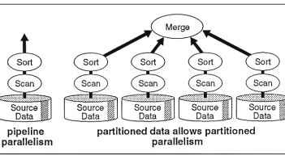
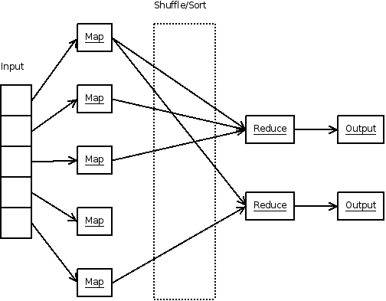
Scalability
Parallel Database
(circa 1990)
Map Reduce
(circa 2005)

Slide 9
Scalability (continued)
Often cited as the main reason for moving from DB technology to NoSQL
DB Position: there is no reason a parallel DBMS cannot scale to 1000’s of nodes
NoSQL Position: a) Prove it; b) it will cost too much anyway

Slide 10
Flavors of NoSQL
Four main types:
• key-value stores
• document databases
• column-family (big-table) stores
• graph databases
=>Here we will talk more about “Document” databases (MongoDB)

Slide 11
Key-Value Stores
There are many systems like that: Redis, MemcacheDB, Amazon's DynamoDB, Voldemort
• Simple data model: key/value pairs
• the DBMS does not attempt to interpret the value
• Queries are limited to query by key
• get/put/update/delete a key/value pair
• iterate over key/value pairs

Slide 12
Document Databases
Examples include: MongoDB, CouchDB, Terrastore
Also store key/value pairs
- However, the value is a document.
• expressed using some sort of semi-structured data model
• XML
• more often: JSON or BSON (JSON's binary counterpart)
• the value can be examined and used by the DBMS (unlike in key/ data stores)
• Queries can be based on the key (as in key/value stores), but more often they are based on the contents of the document.
• Here again, there is support for sharding and replication.
• the sharding can be based on values within the document
Sharding is a method for distributing data across multiple machines.

Slide 13
The Structure Spectrum
Structured (schema-first)
Semi-Structured (schema-later)
Unstructured (schema-never)
Relational Database
DocumentsXML
Plain Text
Media
Formatted Messages
Tagged Text/Media

Slide 14
MongoDB (An example of a Document Database)
-Data are organized in collections. A collection stores a set of documents.
Collection like table and document like record
but: each document can have a different set of attributes even in the same collection
Semi-structured schema!
Only requirement: every document should have an “_id” field

Slide 15
Example mongodb
{ "_id”:ObjectId("4efa8d2b7d284dad101e4bc9"),
"Last Name": ” Cousteau",
"First Name": ” Jacques-Yves",
"Date of Birth": ”06-1-1910" },
{ "_id": ObjectId("4efa8d2b7d284dad101e4bc7"),
"Last Name": "PELLERIN",
"First Name": "Franck",
"Date of Birth": "09-19-1983",
"Address": "1 chemin des Loges",
"City": "VERSAILLES" }

Slide 16
Example Document Database: MongoDB
Key features include:
• JSON-style documents
• actually uses BSON (JSON's binary format)
• replication for high availability
• auto-sharding for scalability
• document-based queries
• can create an index on any attribute
• for faster reads

Slide 17
MongoDB Terminology
relational term <== >MongoDB equivalent
----------------------------------------------------------
database <== > database
Relation or table <== > collection
Tuple or row <== > document
attributes <== > fields (field-name:value pairs)
primary key <== > the _id field, which is the key associated with the document

Slide 18
JSON
JSON is an alternative data model for
semi-structured data.
• JavaScript Object Notation
• Built on two key structures:
• an object, which is a sequence of name/value pairs
{ ”_id": "1000",
"name": "Sanders Theatre",
"capacity": 1000 }
• an array of values [ "123", "222", "333" ]
• A value can be:
• an atomic value: string, number, true, false, null
• an object
• an array

Slide 19
The _id Field
Every MongoDB document must have an _id field.
• its value must be unique within the collection
• acts as the primary key of the collection
• it is the key in the key/value pair
• If you create a document without an _id field:
• MongoDB adds the field for you
• assigns it a unique BSON ObjectID
• example from the MongoDB shell:
> db.test.save({ rating: "PG-13" })
> db.test.find() { "_id" :ObjectId("528bf38ce6d3df97b49a0569"), "rating" : "PG-13" }
• Note: quoting field names is optional (see rating above)

Slide 20
Data Modeling in MongoDB
Need to determine how to map
entities and relationships => collections of documents
• Could in theory give each type of entity:
• its own (flexibly formatted) type of document
• those documents would be stored in the same collection
• However, it can make sense to group different types of entities together.
• create an aggregate containing data that tends to be accessed together

Slide 21
Capturing Relationships in MongoDB
Two options:
1. store references to other documents using their _id values
2. embed documents within other documents

Slide 22
Example relationships
Consider the following documents examples:
{
"_id":ObjectId("52ffc33cd85242f436000001"),
"name": "Tom Hanks",
"contact": "987654321",
"dob": "01-01-1991"
}
{
"_id":ObjectId("52ffc4a5d85242602e000000"),
"building": "22 A, Indiana Apt",
"pincode": 123456,
"city": "Los Angeles",
"state": "California"
}
Here is an example of embedded relationship:
{
"_id":ObjectId("52ffc33cd85242f436000001"),
"contact": "987654321",
"dob": "01-01-1991",
"name": "Tom Benzamin",
"address": [
{
"building": "22 A, Indiana Apt",
"pincode": 123456,
"city": "Los Angeles",
"state": "California"
},
{
"building": "170 A, Acropolis Apt",
"pincode": 456789,
"city": "Chicago",
"state": "Illinois"
}
]
}
And here an example of reference based
{
"_id":ObjectId("52ffc33cd85242f436000001"),
"contact": "987654321",
"dob": "01-01-1991",
"name": "Tom Benzamin",
"address_ids": [
ObjectId("52ffc4a5d85242602e000000"),
ObjectId("52ffc4a5d85242602e000001")
]
}

Slide 23
Other Structure Issues
NoSQL: a) Tables are unnatural, b) “joins” are evil, c) need to be able to “grep” my data
DB: a) Tables are a natural/neutral structure, b) data independence lets you precompute joins under the covers, c) this is a price of all the DBMS goodness you get
This is an Old Debate – Object-oriented databases, XML DBs, Hierarchical, …

